Slide 1
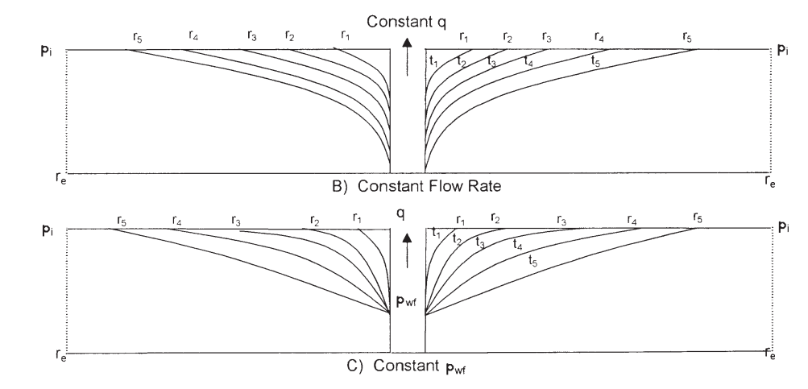
UNSTEADY-STATE FLOW
The transient (unsteady-state) flow is defined as that time period during which the boundary has no effect on the pressure behavior in the reservoir and the reservoir will behave as its infinite in size.

Slide 2
General partial differential equation

Slide 3
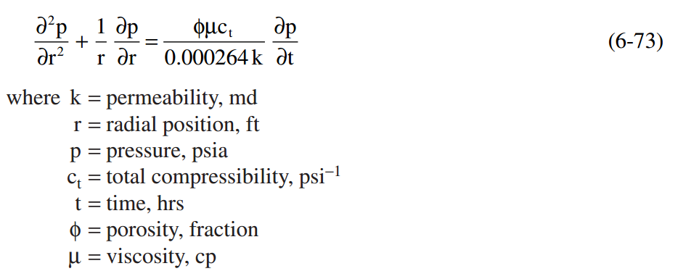
Radial Flow of Slightly Compressible Fluids

Slide 4
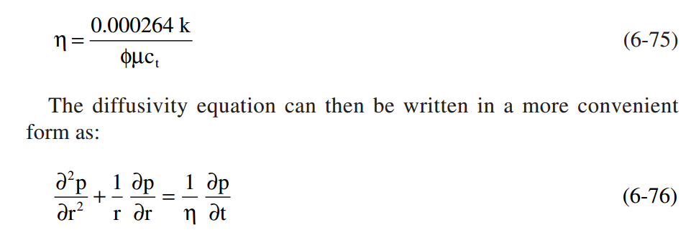
Before discussing and presenting the different solutions to the diffusivity equation, it is necessary to summarize the assumptions and limitations used in developing Equation 6-76

Slide 7
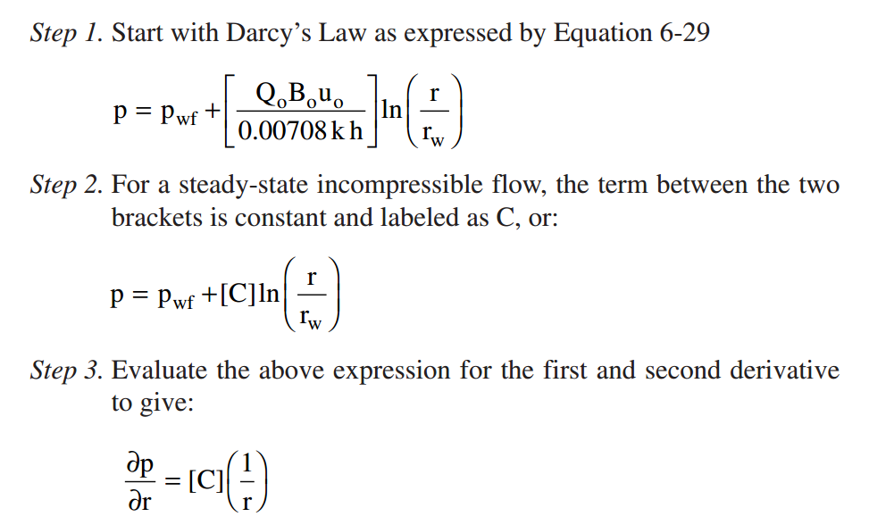

Slide 8
